Slide 1
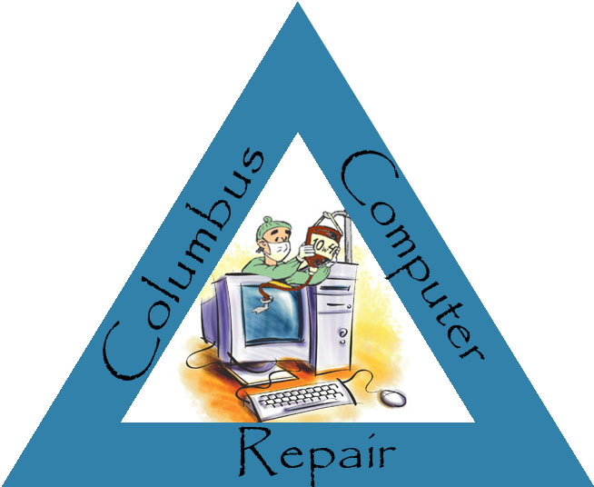
IT Solutions by: A.O.L. Consultant Group
Michael Abbott, James Orcutt, & Anthony Lagrass

Slide 2
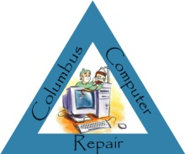
Columbus Computer Repair began in 1998 with John D’Amato and George Schultz, two college students who turned their apartment near the campus of The Ohio State University into an ad hoc computer repair shop. At first, John and George fixed computers for friends and family as a way to help pay for school, but as word spread throughout campus and beyond, their repair business quickly grew too large for the confines of their small off-campus apartment. Columbus Computer Repair was incorporated early in 1999, and moved to a small warehouse in downtown Columbus, where John and George could better accommodate the growing demand for their services. Unfortunately, their workload became so heavy that the young college students had to put their education on hold.
Not too long after Columbus Computer Repair moved into its new home in downtown Columbus, the tech bubble burst, putting many fledgling IT companies out of business. It very nearly did the same to the young computer repair company. The recession that followed forced many businesses to cut costs anyway they could, including extending the productive lives of their tech assets. Columbus Computer Repair’s quality and low-cost repair and refurbishment services became the saving grace of many companies during those rough economic times.
As the economy slowly and steadily improved, John’s and George’s business continued to grow. By 2003, Columbus Computer Repair had opened up six new repair shops in Central Ohio. Two years later, it had expanded throughout Ohio and extended its reach into neighboring states, with fifty shops located in Ohio, Pennsylvania, Michigan, and Indiana. By 2008, that number doubled, and Columbus Computer Repair had shops throughout the Midwest, as well as repair shops in New York, Florida, California, and Texas.
Columbus Computer Repair had found its niche early on, but as the Green IT movement gained steam in the latter half of the past decade, the company grew to provide resale and recycling services to its many corporate customers. Not only could their business clients have their IT equipment repaired, they now could sell their old equipment back to Columbus Computer Repair for resale or for responsible recycling by reputable e-recyclers. This benefitted the repair shop’s corporate customers in two ways. The first way was the enhancement of that company’s bottom line, as they shared in the proceeds from the resale of computers with Columbus Computer Repair. The second was the reputation the business received from being a friend to the environment. It was a win-win for everybody involved, including the customers who bought the refurbished computers, as they got a sound product for a reasonable price.
As governments and businesses worldwide increasingly recognize the importance of responsible use and disposal of technology, and as the rapid advance and expanded usage of computers in our daily lives continues; Columbus Computer Repair will remain an important force in the field of IT asset reclamation and recycling.

Slide 3

At Columbus Computer Repair, our mission is to extend the usable lives of computers by providing quality, inexpensive repair, refurbishment, and recycling services for household and small business users. By providing a way for businesses and everyday users to extend the productive lives of their computers, we save them money. We save the environment by reusing technology that has not reached the end of its life cycle and by responsibly recycling the computers that we cannot repair.
How We Do It
At Columbus Computer Repair, our A+ Certified technicians diagnose the problem, determine what steps need to be taken to repair the problem, and then perform the repair. Our repair parts, often harvested from non-repairable units, are thoroughly tested for functionality before being used in our repair process.

Slide 4
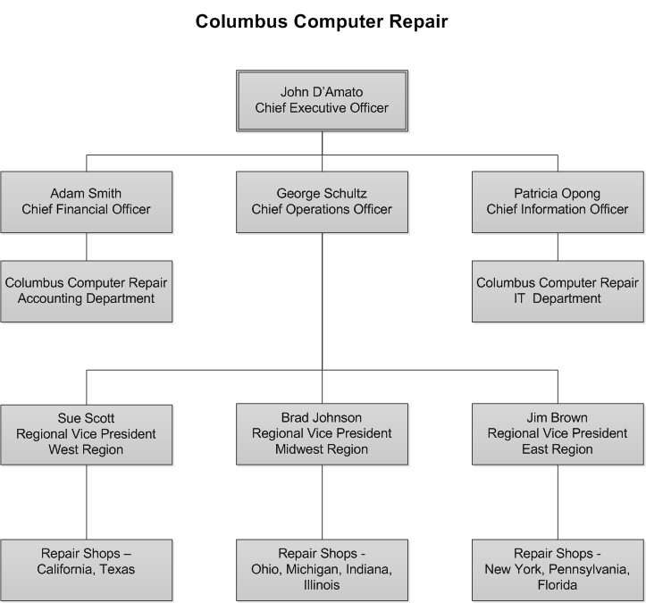

Slide 5
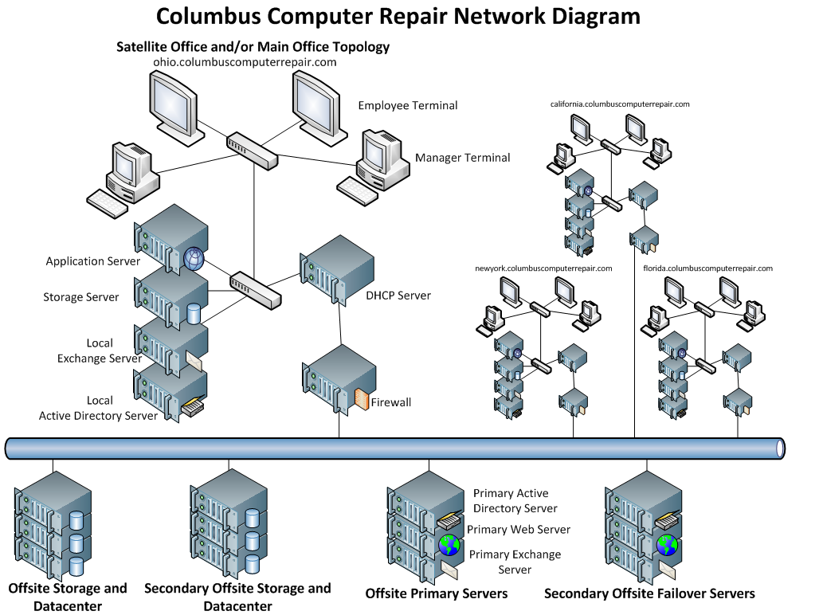

Slide 6

After careful analysis of Columbus Computer Repair’s current information system and assessment of their current and future business needs, Abbott, Orcutt & LaGrass Consultant Group has determined that the best IT solution for Columbus Computer Repair would be to implement three-tier application architecture using the principles of object-oriented programming and design.

Slide 7
Repairs Performed by Technician Detail Report
Shop managers at Columbus Computer Repair will need to access daily reports detailing repairs performed by individual technician on a particular shift for the purposes of technician assessment.
Parts Inventory Detail Report
Inventory associates at Columbus Computer Repair will need to access daily reports detailing repair parts currently in inventory for the purpose of maintaining an accurate inventory count, for ordering repair parts if inventory is low, and for researching inventory variances.
Repair Shop Productivity Summary Report
Business analysts at Columbus Computer Repair will need to access monthly reports summarizing the productivity level of repair shops within their area of responsibility for the purpose of fine-tuning repair shop operations.

Slide 8
Customer Order Summary Report
Business analysts will need to access reports summarizing the volume of business done with Columbus Computer Repair’s corporate customers for customer and business analysis purposes. Corporate salespeople may also need access to these reports for pertinent customer information.
Employee Detail Report
Human resources personnel will need to access reports detailing employees at their repair shop.

Slide 9
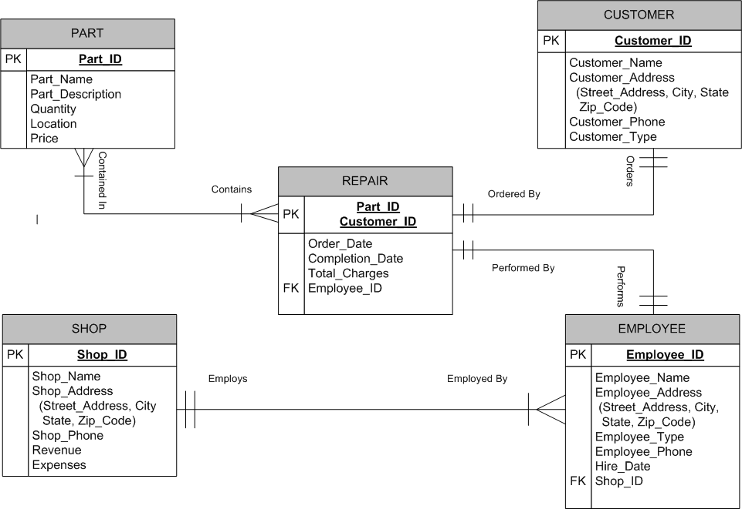

Slide 10
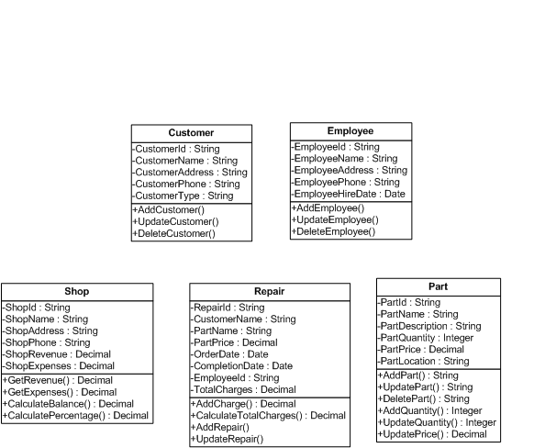

Slide 11
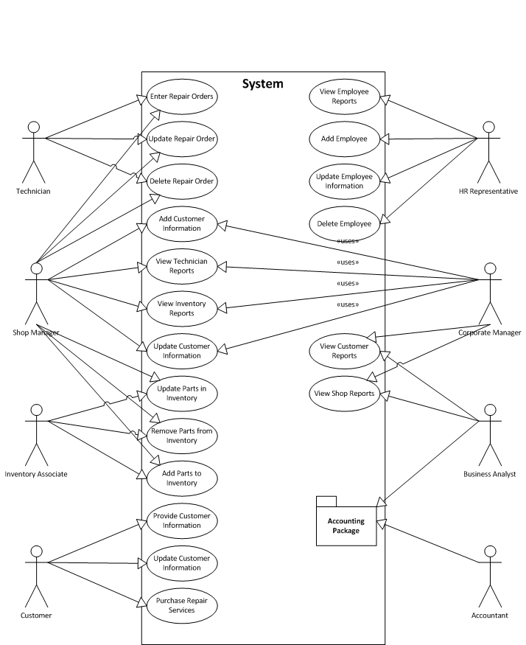
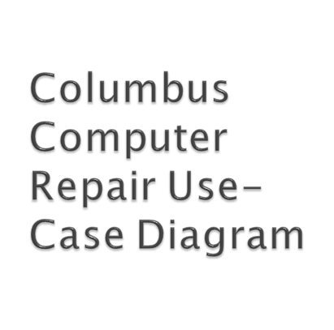

Slide 12

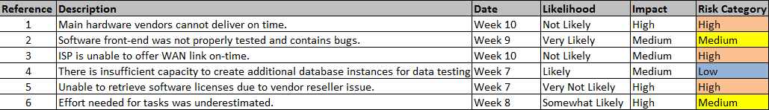
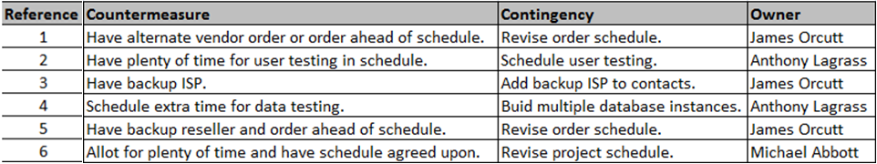

Slide 13
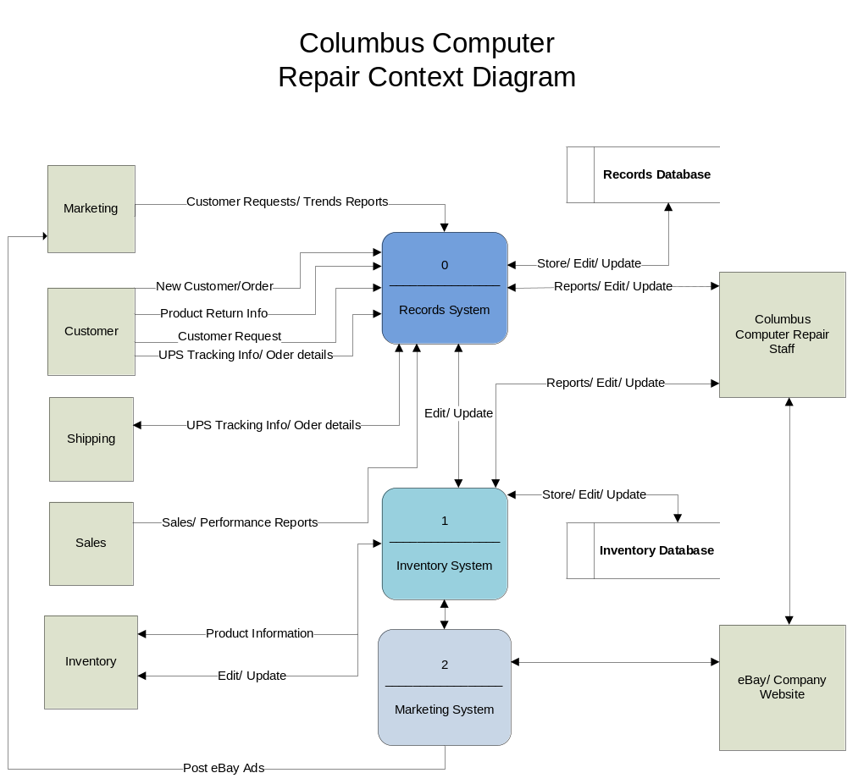

Slide 14
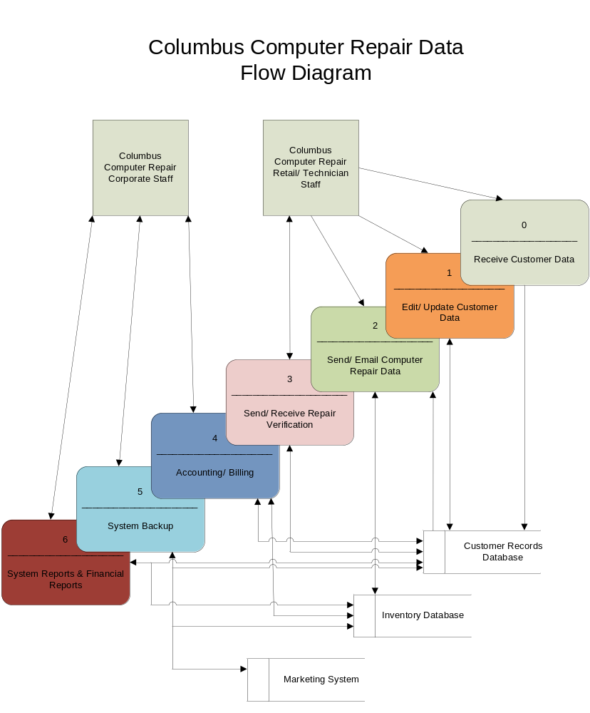

Slide 15


